Slide 1
The GFC

Slide 2
1Jn 2:16 For all that is in the world, the lust of the flesh, and the lust of the eyes, and the pride of life, is not of the Father, but is of the world.
1Jn 2:17 And the world passeth away, and the lust thereof: but he that doeth the will of God abideth forever.

Slide 3
1Ti 6:6 But godliness with contentment is great gain.
1Ti 6:7 For we brought nothing into this world, and it is certain we can carry nothing out.
1Ti 6:8 And having food and raiment let us be therewith content.
1Ti 6:9 But they that will be rich fall into temptation and a snare, and into many foolish and hurtful lusts, which drown men in destruction and perdition.
1Ti 6:10 For the love of money is the root of all evil: which while some coveted after, they have erred from the faith, and pierced themselves through with many sorrows.
1Ti 6:11 But thou, O man of God, flee these things; and follow after righteousness, godliness, faith, love, patience, meekness.

Slide 4
righteousness,
godliness,
faith,
love,
patience,
meekness.

Slide 5
Gen 11:1 And the whole earth was of one language, and of one speech.
Gen 11:2 And it came to pass, as they journeyed from the east, that they found a plain in the land of Shinar; and they dwelt there.
Gen 11:3 And they said one to another, Go to, let us make brick, and burn them throughly. And they had brick for stone, and slime had they for mortar.
Gen 11:4 And they said, Go to, let us build us a city and a tower, whose top may reach unto heaven; and let us make us a name, lest we be scattered abroad upon the face of the whole earth.

Slide 6
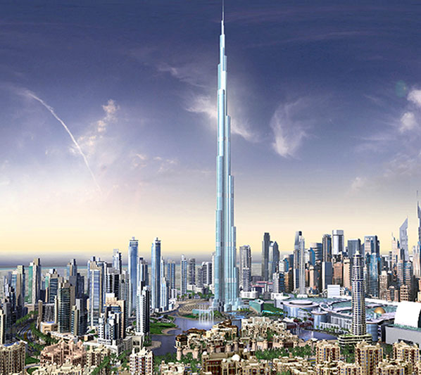

Slide 7
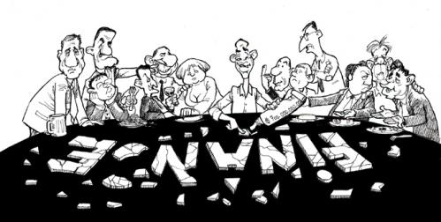
What is the GFC?
GFC refers to the Global Financial Crisis that occurred between Sept and Nov 2008.
Global credit markets ceased to function which lead to the near total collapse of the world financial system.
Total catastrophe was only narrowly averted by unprecedented government intervention and global co-ordination.
Large chunks of private borrowing (measured in trillions) were taken over by public money in almost every country in the world.
The result was a halving
of global stock markets
, a 30%+ fall in property
values and the instant
demise of 100’s of
large corporations and
countless smaller ones
in a matter of weeks.

Slide 8
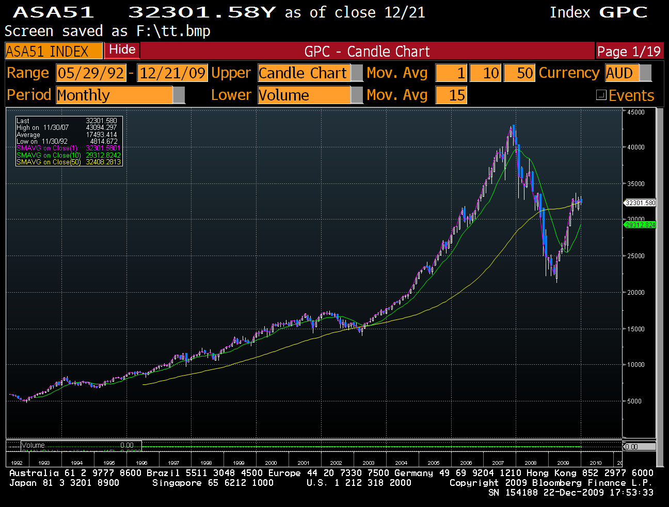
Source: Bloomberg

Slide 9
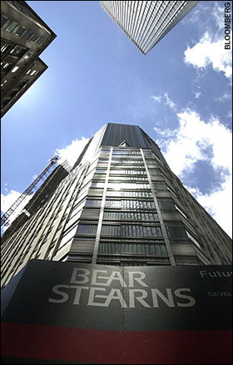
Source: Bloomberg

Slide 10
Source: Bloomberg

Slide 11
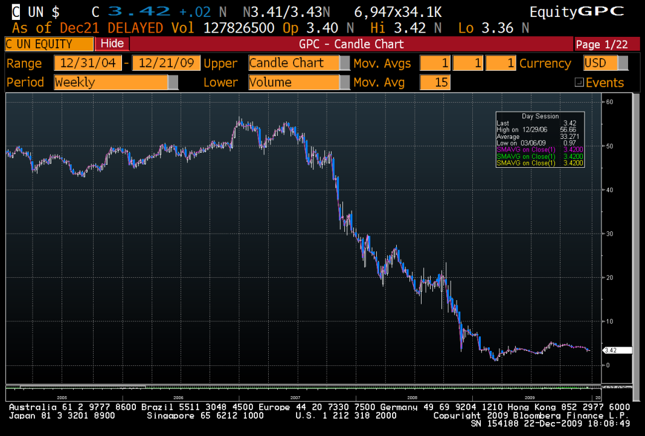
Worlds biggest bank
Citi Group
$55 per share to 20 cents
Source: Bloomberg

Slide 12
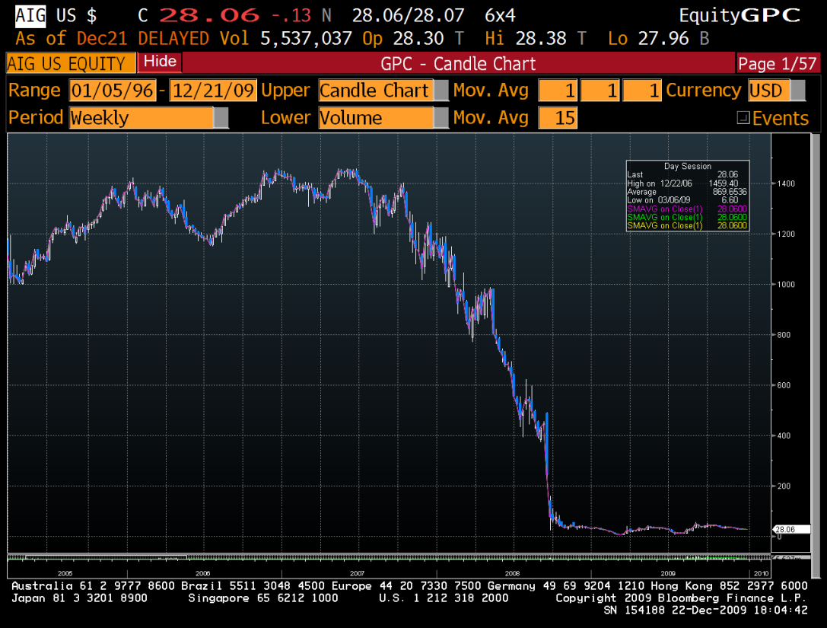
Worlds biggest insurer
American Insurance Group
$1450 per share to 25 cents

Slide 13
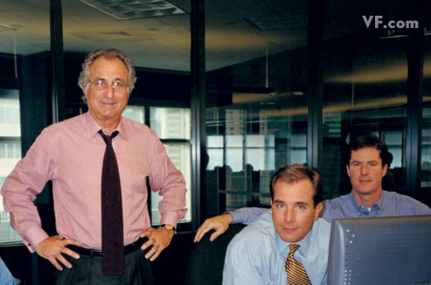
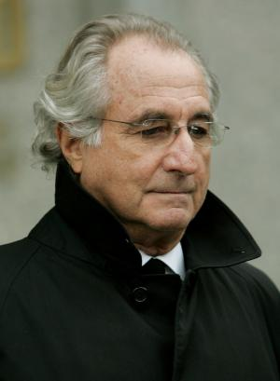
Bernie Madoff – Perpetrator of the Biggest Swindle in History... 170 billion dollars

Slide 14
“The biggest crisis since the second world war”
“The worst economic scenario since the great depression”
“For a few weeks in late 2008 we were staring into the Abyss”
“We expect to see unemployment triple over the next few years”
“The death of capitalism”
“The end of the free market experiment”
“The Great Depression all over again”
“Over 30 trillion dollars of wealth destroyed”

Slide 15
Text Book for Understanding the GFC

Slide 16
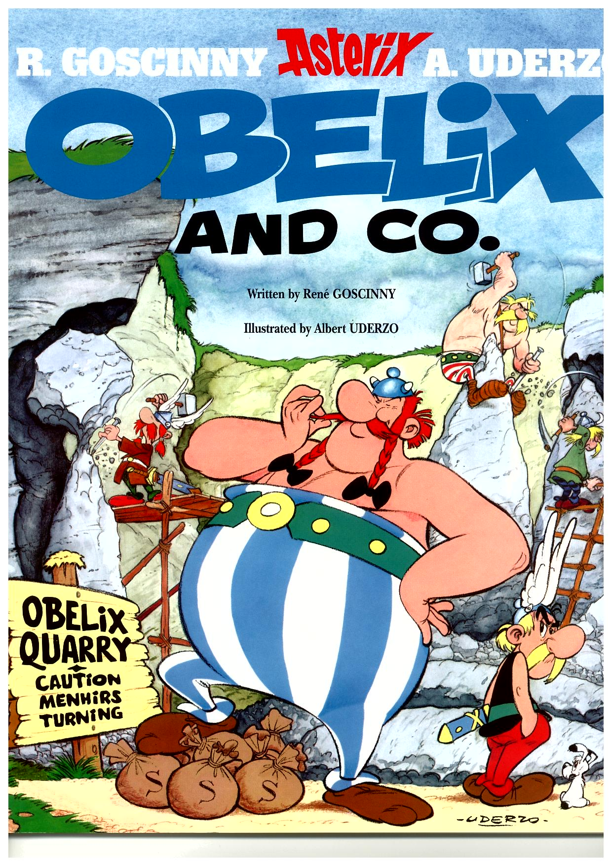
The Plot:
A whizkid from the Londinium
school of economics, dreams up a
way to subdue the Gaulish village:
Buy their Menhirs and flood the
village with money.
They will forget about fighting the
Romans and focus on making
lots of money.
The GFC

Slide 17
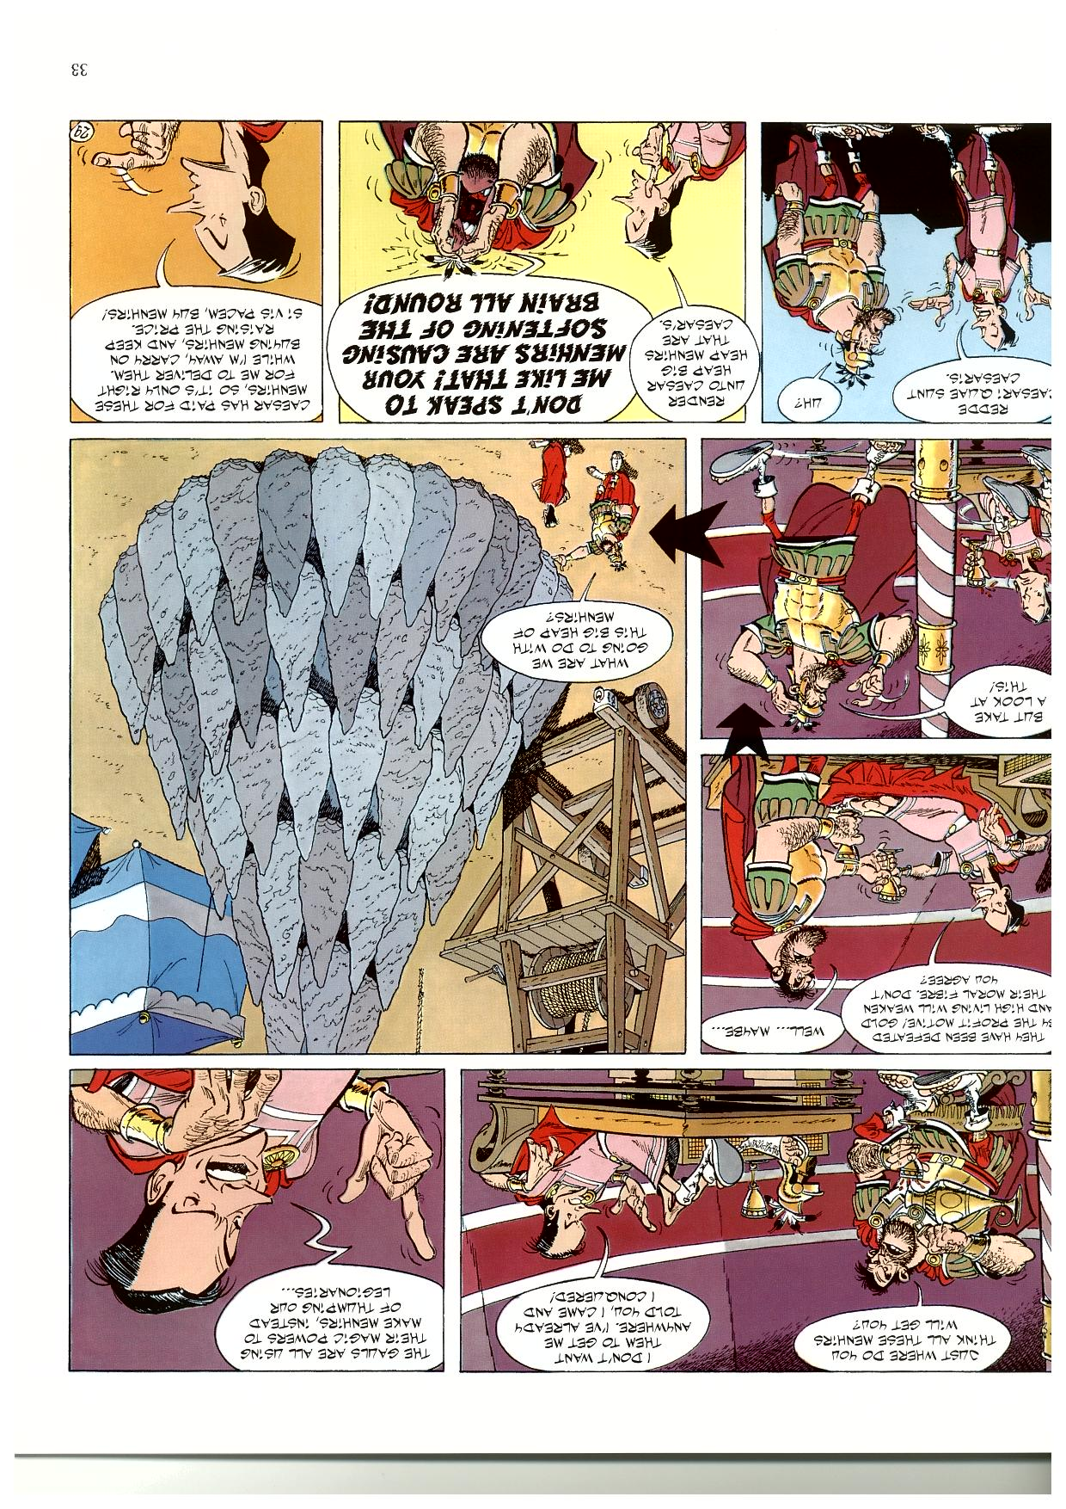
This leads to a surfeit of menhirs for the Romans......

Slide 18
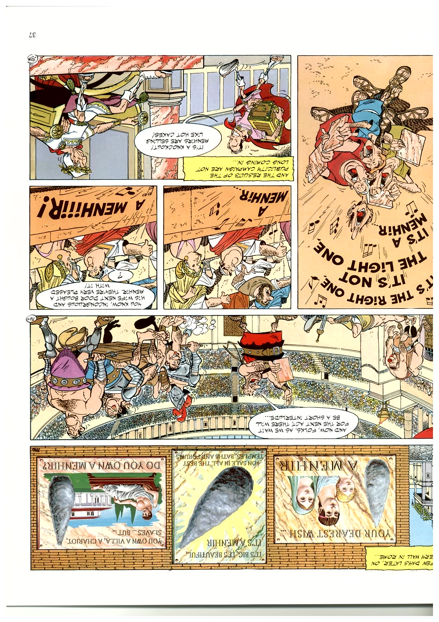
........ who dream up
Innovative marketing programs to sell them..........

Slide 19
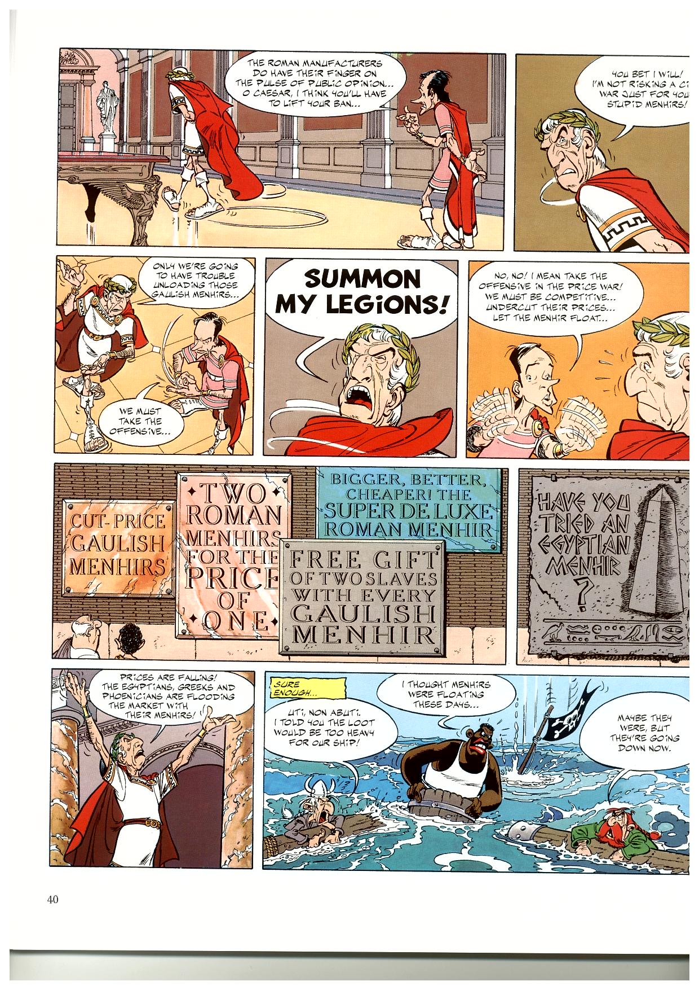
........ Before long
Rome is being flooded with imitations................
........ And prices are being cut................

Slide 20
........ And a full on price crash ensues..........

Slide 21
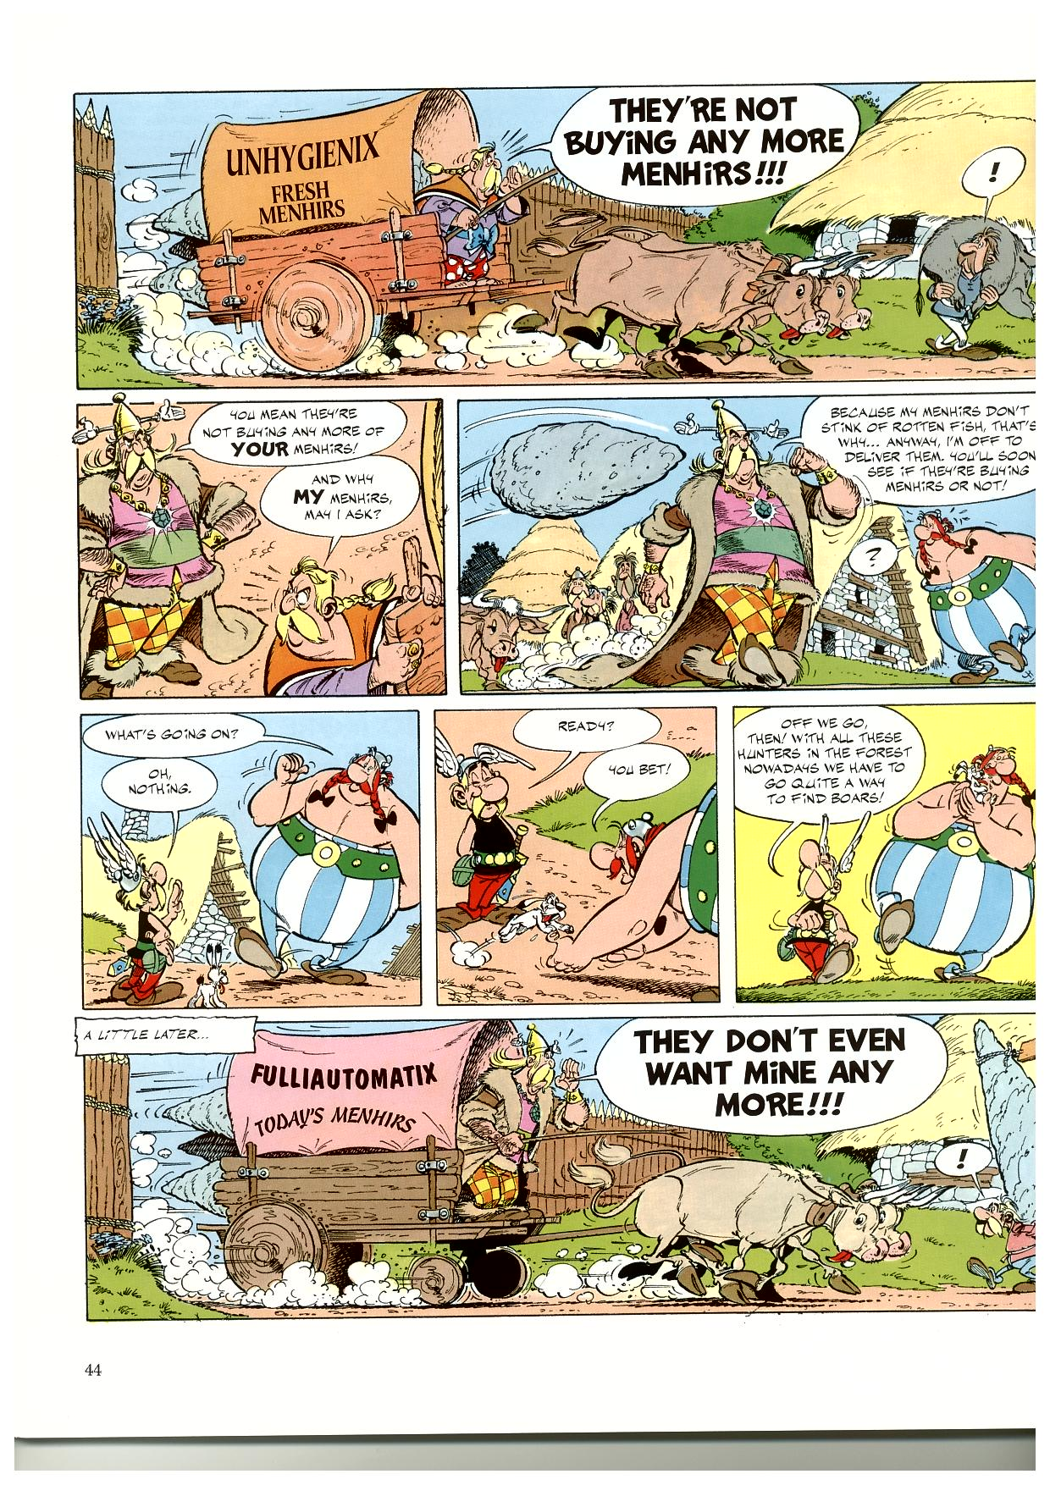
........ Filtering down to the Producers in the Village..........

Slide 22
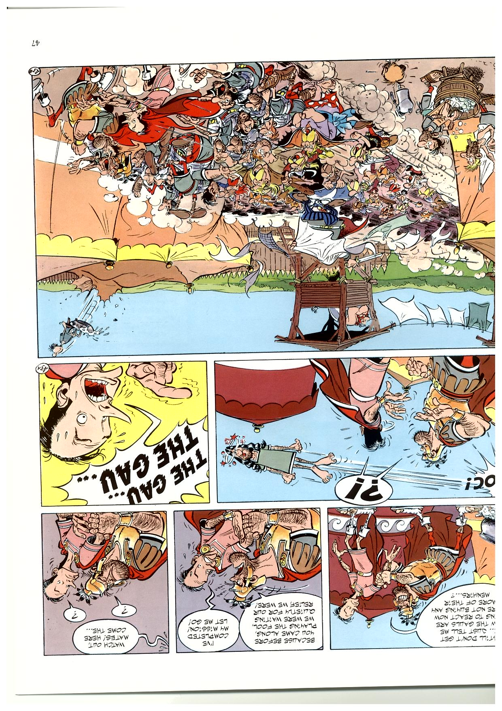
........ And ending in the inevitable Crash........

Slide 23
So why did it happen?

Slide 24
What we will do in this Presentation
-Two foundation principles of Economics
-What Actually Happened in the GFC
-What impact it is likely to have on:
Russia, Europe, Israel, Australia
-Close with some thoughts about our times
Liberal economics, and the return of Christ

Slide 25
Two Foundation Principles
of Finance and Economics:
Money
Supply and Demand

Slide 26
Money

Slide 27
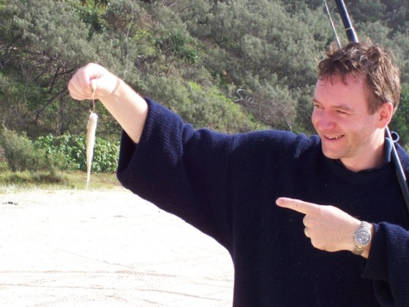
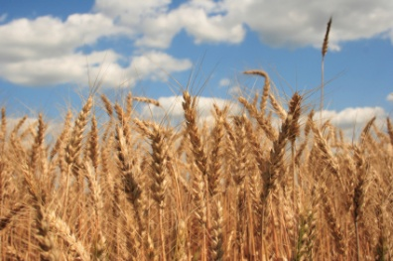
First Money - BARTER
Grain
1 Fish = 100 Grains
Fish
Notes:
Dart – merrily swimming along when out of nowhere a hook jagged it in the belly and the next thing it knew it was hauled roughly through the crashing surf and hoisted in the air where it hung limply while an ugly giant with 3 days stubble pointed at it. A metaphor for what happens in life sometimes. Unfortunately for the fish it was valuable and could be esxchanegd for some Grain

Slide 28
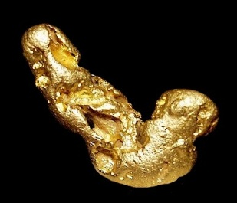
And Then........ Commodity Money
1 Fish = 100 Grains
Grain
Fish
How Many Fish
For: 1 Shekel?
1 Shekel = _?_ Fish
1 Shekel = 1000 Grains
Gold
Notes:
Dart – merrily swimming along when out of nowhere a hook jagged it in the belly and the next thing it knew it was hauled roughly through the crashing surf and hoisted in the air where it hung limply while an ugly giant with 3 days stubble pointed at it. A metaphor for what happens in life sometimes. Unfortunately for the fish it was valuable and could be esxchanegd for some Grain

Slide 29
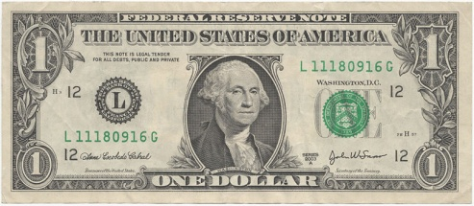
And Then........ Fiat Money
1 Fish = 100 Grains
Grain
Fish
$10 = 1 Shekel
1 Shekel = 10 Fish
1 Shekel = 1000 Grains
Gold

Slide 30
And Then........... Fiat Money
Grain
$10 = 10 Fish
Fish
$10 = 1000 Grains
Bank Account Statement
Simon O’Grady
Balance: $10.00
Fiat Money:
-Has no intrinsic value.
-Works only because everyone agrees
The one thing that brings the whole thing to a screaming halt is:
A breakdown in confidence
$10 = 1 (Shekel)
Gold
Notes:
And it only works if you have confidence about 2 things:
The next guy is going to agree to exchange it
There is some way of knowing what the exchange should be

Slide 31
The Law of
Supply and Demand

Slide 32
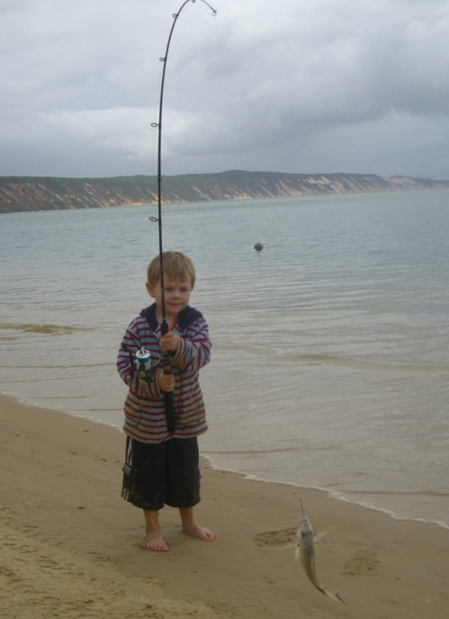
Supply and Demand......................
What Happens to the price of gold if........
Spain invades the Aztecs and nicks all their Gold
What Happens to the value of money if........
The Fed prints lots more plastic bills?
What Happens to the price of fish if.............
The son goes fishing and catches twice as many fish?
What Happens to the price of grain if........
There is no rain and the grain doesn’t grow
They don’t have to print bills anymore... They
just put money into peoples accounts.......
Its called “increasing the money supply”.
Grain
$10 = 20 Fish
Fish
Bank Account Statement
Simon O’Grady
Balance: $20.00
$10 = 1000 Grains
$10 = 1 Gram (Shekel)
Gold
Notes:
Dart – merrily swimming along when out of nowhere a hook jagged it in the belly and the next thing it knew it was hauled roughly through the crashing surf and hoisted in the air where it hung limply while an ugly giant with 3 days stubble pointed at it. A metaphor for what happens in life sometimes. Unfortunately for the fish it was valuable and could be esxchanegd for some Grain

Slide 33
The Causes

Slide 34
The Tech Boom and Bust….. Back in 2002

Slide 35
Money Supply Increased Enormously..........

Slide 36
Oil
Gas
Gold
Silver
Copper
Iron
Coal
AUD
Property
Sheeps
All hit all time highs and then
proceeded to go ballistic.......
The World was flooded with cheap
USD and no where to put it.........

Slide 37
So down at the modern version of the Londinium
School of economics
The PHD whiz kids were at work..........
Cheap Money
Loads of it
And no where to go................
Let’s create a new market............................
SUB PRIME !!!

Slide 38
SUB PRIME.... Is essentially a band of borrowers who
are such a bad risk that banks will not lend to them.
But what if you could find a way............
And they found one......
Here it is..............

Slide 39
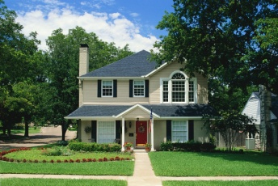

Banking – in the “old” days
“Borrowers”
X% Interest
“Banks”
“Due Diligence”
X% interest less a Fat Margin
The Bank takes the risk
“Investors”

Slide 40


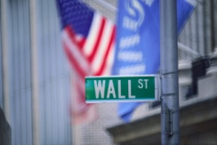
“Borrowers”
“Special Investment
Vehicles” (SIV’s)
“Mortgage Brokers”
“Banks”
The SIV takes
the risk
and passes it
back to
the
Investor
“Investors”

Slide 41
"Not Me"
“Borrowers”
“Special Investment
Vehicles” (SIV’s)
"Not Me"
“Mortgage Brokers”
"Not Me"
"Not Me"
“Banks”
“Investors”
"Who ... Me?"

Slide 42
“Borrowers”
“Special Investment
Vehicles” (SIV’s)
fee
“Mortgage Brokers”
Fee
“Banks”
Fee
“Investors”

Slide 43
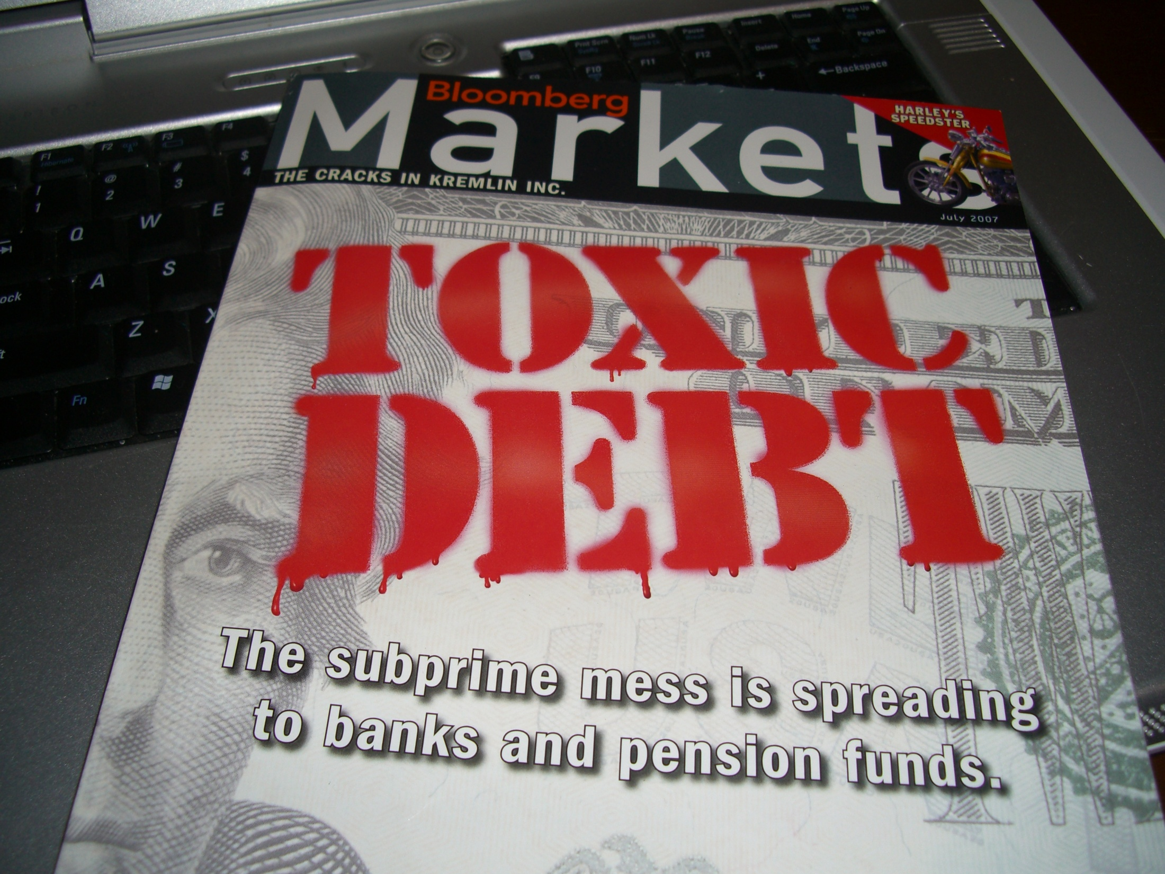
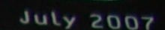
The Causes

Slide 44
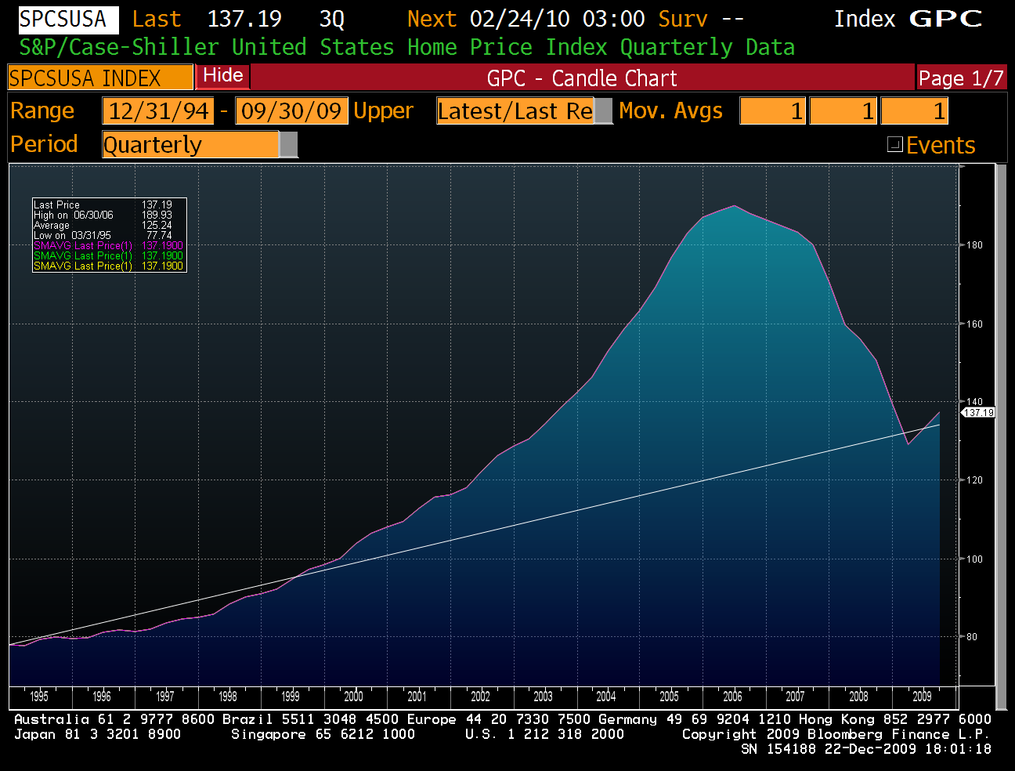
A Runaway Housing Bubble
- House Prices Doubled
And then.......................
Source: Bloomberg

Slide 45
Wall Street
Mortgages
Mortgages
Bear Stearns

Slide 46
A Runaway Housing Bubble
- House Prices Doubled
And then.......................
Source: Bloomberg

Slide 47
Source: Bloomberg

Slide 48
“The biggest crisis since the second world war”
“The worst economic scenario since the great depression”
“We expect to see unemployment triple over the next few years”
“The death of capitalism”
“The end of the free market experiment”
“The Great Depression all over again”

Slide 49
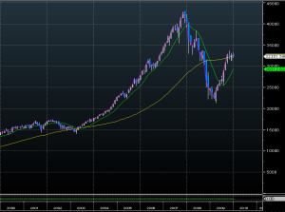
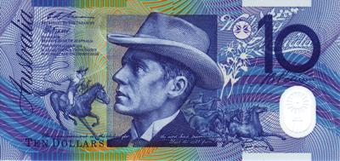
And Then........... Fiat Money
The Stock Market
- Businesses
Real
Assets
Property
Grain
Fish
Bank Account Statement
Simon O’Grady
Balance: $100.00
Gold
Notes:
And it only works if you have confidence about 2 things:
The next guy is going to agree to exchange it
There is some way of knowing what the exchange should be

Slide 50
Source: Bloomberg

Slide 51
1973 Oil Crisis & Inflation Shock
1987 Stock Market Crash
1992 Savings and Loan Crisis
1998 Asian Crisis
2003 Tec Wreck
2008 -2010 The GFC & Recession
2011....2012...... ????

Slide 52
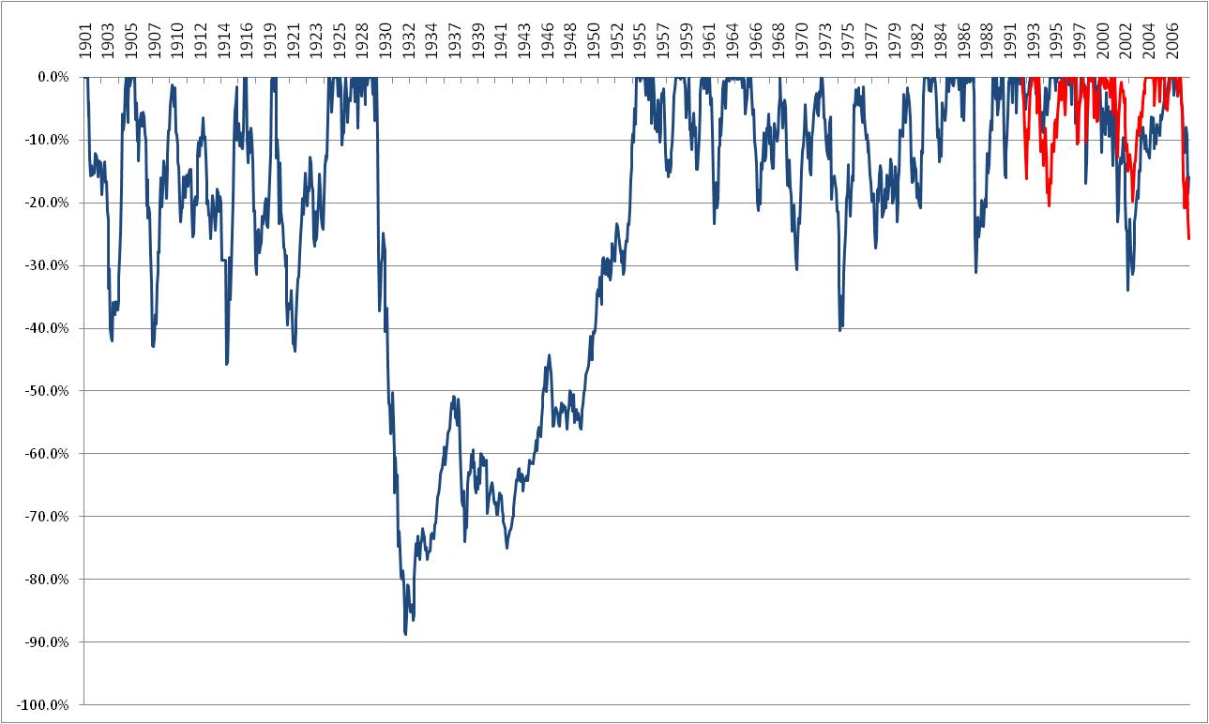
Equity Market Drawdowns............
Peak to Trough % Fall in Global Stock Market 1900-2009
“... I would like to say to Milton (Friedman) and Anna (Schwartz): Regarding the Great Depression. You're right, we did it. We're very sorry. But thanks to you, we won't do it again.”
Ben Bernanke. Nov 2002
Current “Crisis” is quite normal
Source: SIM

Slide 53
Catastrophe Avoided!!!??

Slide 54
The Outcome

Slide 55
What do we Expect at the end...............................
The Ecclesia................
1Th 5:1 But of the times and the seasons, brethren, ye have no need that I write unto you.
1Th 5:2 For yourselves know perfectly that the day of the Lord so cometh as a thief in the night.
1Th 5:3 For when they shall say, Peace and safety; then sudden destruction cometh upon them, as travail upon a woman with child; and they shall not escape.
1Th 5:4 But ye, brethren, are not in darkness, that that day should overtake you as a thief.

Slide 56
What do we Expect at the end...............................
The World................
Mat 24:37 But as the days of Noah were, so shall also the coming of the Son of man be.
Mat 24:38 For as in the days that were before the flood they were eating and drinking, marrying and giving in marriage, until the day that Noah entered into the ark,
Mat 24:39 And knew not until the flood came, and took them all away; so shall also the coming of the Son of man be.

Slide 57
What do we Expect at the end..............................
The Northern Invader..................
Eze 38:3 And say, Thus saith the Lord GOD; Behold, I am against thee, O Gog, the chief prince of Meshech and Tubal:
Eze 38:4 And I will turn thee back, and put hooks into thy jaws, and I will bring thee forth, and all thine army, ..... and many people with thee.
Eze 38:7 Be thou prepared, and prepare for thyself, thou, and all thy company that are assembled unto thee, and be thou a guard unto them.
Eze 38:15 And thou shalt come from thy place out of the north parts, thou, and many people with thee, all of them riding upon horses, a great company, and a mighty army:

Slide 58
What do we Expect at the end..............................
Europe..................
Alas, alas that great city Babylon, that mighty city! for in one hour is thy judgment come.
Rev 18:11 And the merchants of the earth shall weep and mourn over her; for no man buyeth their merchandise any more:
Rev 18:15 The merchants of these things, which were made rich by her, shall stand afar off for the fear of her torment, weeping and wailing,
Rev 18:16 And saying, Alas, alas that great city, that was clothed in fine linen, and purple, and scarlet, and decked with gold, and precious stones, and pearls!
Rev 18:17 For in one hour so great riches is come to naught.
And every shipmaster, and all the company in ships, and sailors, and as many as trade by sea, stood afar off,
Rev 18:18 And cried when they saw the smoke of her burning, saying, What city is like unto this great city!

Slide 59
What do we Expect at the end..............................
Israel..................
Eze 38:12 To take a spoil, and to take a prey; to turn thine hand upon the desolate places that are now inhabited, and upon the people that are gathered out of the nations, which have gotten cattle and goods, that dwell in the midst of the land.

Slide 60
So what’s next… is this the end of capitalism?
Unlikely:
Huge Govt policy response
Price adjustment is done
Unlike the depression:
-No global trade war
-No formal tightening in money supply
-No hike in taxes (yet?)
What’s most likely is:
Slow and gradual recovery
Punctuated by bouts of risk aversion related to high debt levels
But followed by a large and synchronised global growth cycle
Whereby we see:
-Russia and Europe become economically and militarily powerful
-Israel at peace and prosperous
-The world in economic good times
-The ecclesia at great risk of apathy

Slide 61
Luk 17:26 And as it was in the days of Noah, so shall it be also in the days of the Son of man.
Luk 17:27 They did eat, they drank, they married wives, they were given in marriage, until the day that Noah entered into the ark, and the flood came, and destroyed them all.
Luk 17:28 Likewise also as it was in the days of Lot; they did eat, they drank, they bought, they sold, they planted, they builded;
Luk 17:29 But the same day that Lot went out of Sodom it rained fire and brimstone from heaven, and destroyed them all.
Luk 17:30 Even thus shall it be in the day when the Son of man is revealed.
Luk 17:31 In that day, he which shall be upon the housetop, and his stuff in the house, let him not come down to take it away: and he that is in the field, let him likewise not return back.
Luk 17:32 Remember Lot's wife.
Luk 17:33 Whosoever shall seek to save his life shall lose it; and whosoever shall lose his life shall preserve it.

Slide 62
The
Swine Flew

Slide 63

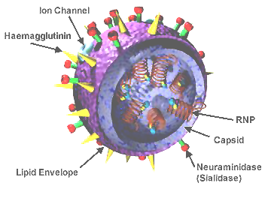
Swine Flu

Slide 64
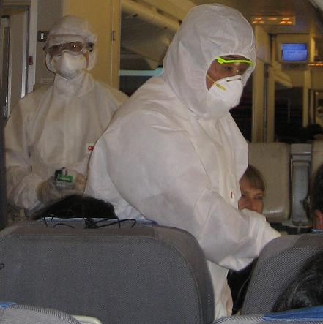

Slide 65
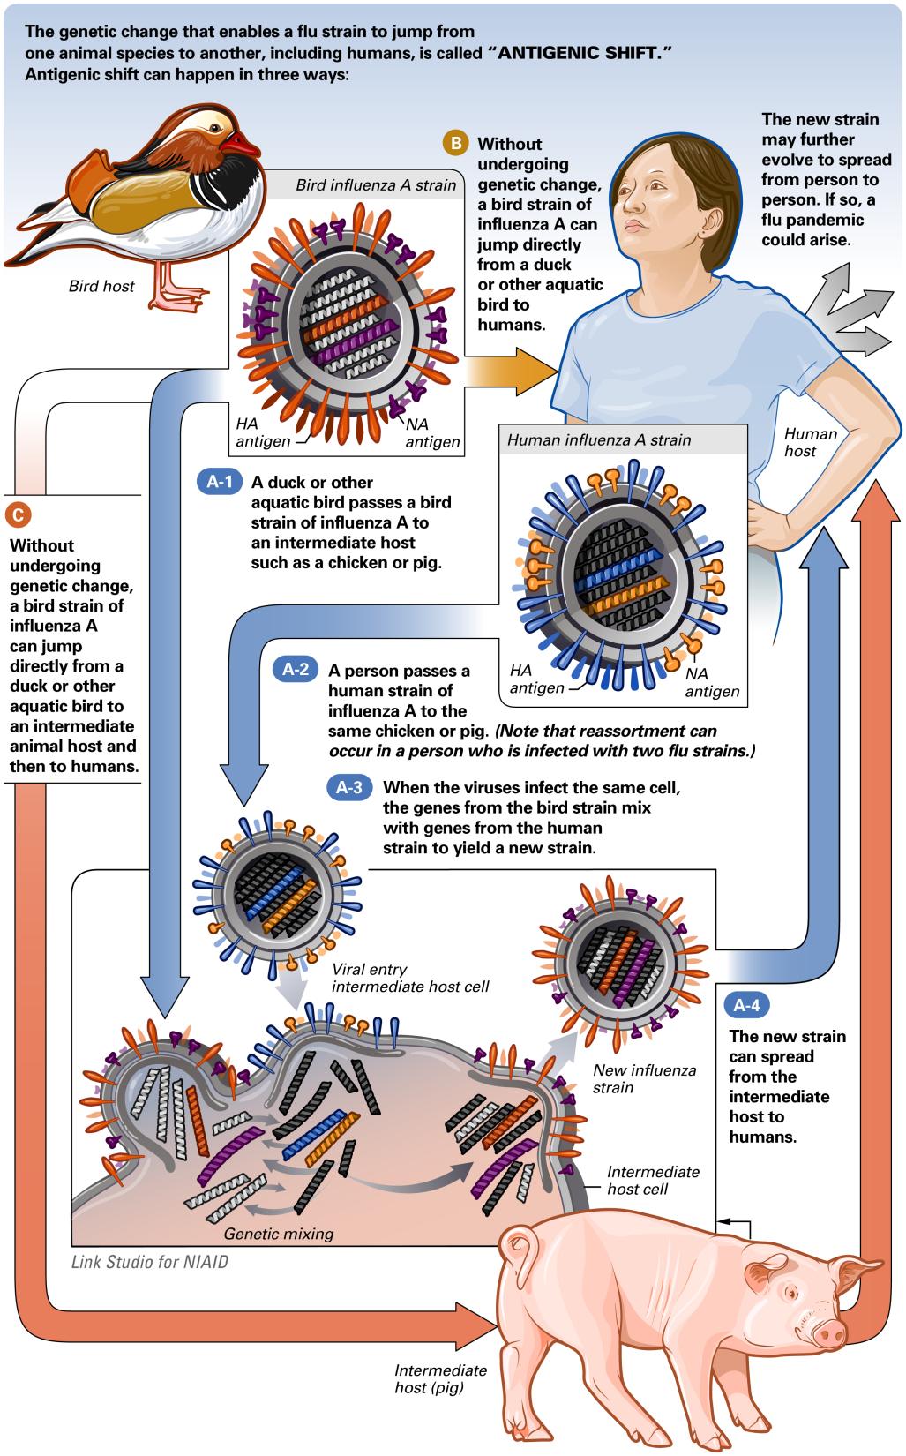

Slide 66
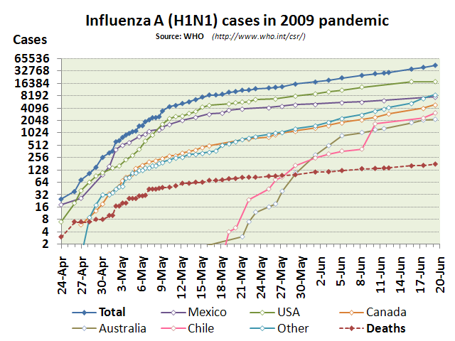

Slide 67
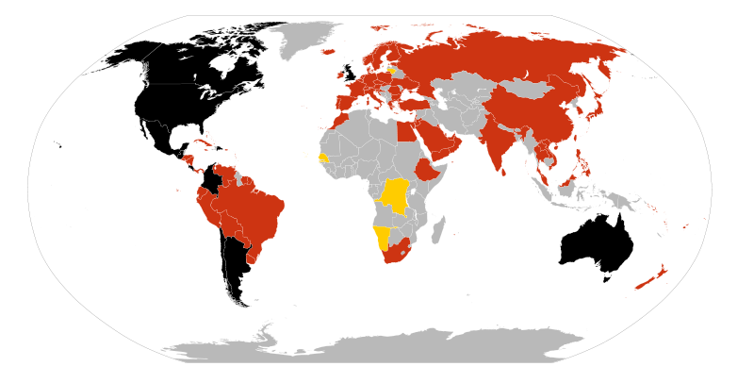
Swine Flu

Slide 68
The Base Things

Slide 69
Dan 4:17 This matter is by the decree of the watchers, and the demand by the word of the holy ones: to the intent that the living may know that the most High ruleth in the kingdom of men, and giveth it to whomsoever he will, and setteth up over it the basest of men.
Dan 2:20 Daniel answered and said, Blessed be the name of God forever and ever: for wisdom and might are his:
Dan 2:21 And he changeth the times and the seasons: he removeth kings, and setteth up kings: he giveth wisdom unto the wise, and knowledge to them that know understanding:

Slide 70
1Co 1:27 But God hath chosen the foolish things of the world to confound the wise; and God hath chosen the weak things of the world to confound the things which are mighty;
1Co 1:28 And base things of the world, and things which are despised, hath God chosen, yea, and things which are not, to bring to naught things that are:
1Co 1:29 That no flesh should glory in his presence.

Slide 71
The “Founders” of Modern Finance & Economic Theory:
Milton Freidman – Monetarist Economics (N)
Greenspan/Bernanke/ – Fed Reserve Chairmen
Paul Krugman – Global Trade (N)
Harry Markowitz/Merton Miller – CAPM (N)
Modigliani – Financial Economics (N)
Von Neumann – Game Theory
Myron Scholes/Fischer Black – Derivatives (N)
Daniel Kahneman – Behavioural Finance (N)
Everyone of these are of Jewish parentage

Slide 72
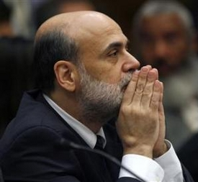
The Key Men fixing up the Mess…………………
Benjamin Bernanke
Chairman of the US Federal Reserve Bank
Rahm Emmanuel
Chief of Staff to the US President
Timothy Geithner
Secretary of the Treasury
All Three are Jewish

Slide 73
The Key inflection points were…………………
Lehman Brothers forced sale
Bear Stearns Bankruptcy
Madoff Debacle

Slide 74
The Big Winner………………… or Whipping Boy….
Goldman Sachs

Slide 75
The American Government
Carter Administration:
Henry Kissinger – Secretary of State
James Schlesinger – Secretary of Defence
John Simon – Secretary of the Treasury
Caspar Weinberger – Sec Health, Educ, Welfare
Arthur Burns – Chairman of Fed Reserve

Slide 76
The American Government
Clinton Administration:
Madeleine Albright – Secretary of State
William Cohen – Secretary of Defense
Robert Rubin – Secretary of the Treasury
Robert Reich – Secretary of Labour
George Tenet – Head of CIA
Evelyn Liebermann – Dep Chief of Staff
Janet Reno – Attorney General
Alan Greenspan – Chair – Federal Reserve

Slide 77
The American Government
Bush II Administration:
Joshua Bolten - Dep Chief of Staff
Paul Wolfowitz – Dep Sec of Defense
Dov Zakheim – Under Sec Defense
Richard Perle – Chair Pentagon Defense Policy
Henry Kissinger – Pentagon Board
I.Lewis Libby – Chief of Staff to Vice President
Alan Greenspan – Chair – Federal Reserve

Slide 78
The American Government
Obama Administration:
Rahm Emanuel- Chief of Staff
Tim Geithner -Secretary of Treasury
Elena Kagan – Solicitor General
James Steinburg– Dep Sec of State
Lawrence Summers– Director Economic Council
David Axelrod – Senior Advisor to President
Ronald Klain– Chief of Staff to Vice President
Ben Bernanke – Chair – Federal Reserve
http://www.jewishvirtuallibrary.org

Slide 79
Jews in the top 10 Richest Forbes List 2008:
USA
Lawrence Ellison – Oracle 3
Michael Bloomberg – Media 5
David Koch – Industry -6
Michael Dell – IT – 7
Sergey Brin – IT – 9
Larry Page –IT – 10
Forbes

Slide 80
The 10 Richest Russians - Forbes List
The Oligarchs of the Putin Years:
Oleg Deripaska
Roman Abramovich
Aleksei Mordashov
Mikhail Fridman
Vladimir Lisin
Mikhail Prokhorov
Vladimir Potanin
Sulejman Kerimov
German Khan
Vagit Alekperov
Forbes

Slide 81
SYDNEY, Australia (JTA) – Australia’s three wealthiest individuals are high-profile members of the Jewish community, according to an annual list.
BRW magazine’s Rich 200 list published this week named Anthony Pratt, who inherited his father Richard’s packaging and recycling company when he died last month, as the nation’s wealthiest individual, followed by shopping mall magnate Frank Lowy and property mogul Harry Triguboff.
http://jta.org/
Jewish families also took out the top three positions in the wealthiest family list Smorgon family ($2.2 billion), Liberman family ($1.8 billion) and Besen family ($1.73 billion).
http://jta.org/
Five of Britain’s ten richest people are Jewish, according to this year’s Sunday Times Rich List.
http://www.thejc.com

Slide 82
1Ti 6:6 But godliness with contentment is great gain.
1Ti 6:7 For we brought nothing into this world, and it is certain we can carry nothing out.
1Ti 6:8 And having food and raiment let us be therewith content.
1Ti 6:9 But they that will be rich fall into temptation and a snare, and into many foolish and hurtful lusts, which drown men in destruction and perdition.
1Ti 6:10 For the love of money is the root of all evil: which while some coveted after, they have erred from the faith, and pierced themselves through with many sorrows.
1Ti 6:11 But thou, O man of God, flee these things; and follow after righteousness, godliness, faith, love, patience, meekness.

Slide 83
Dan 7:17 These great beasts, which are four, are four kings, which shall arise out of the earth.
Dan 7:18 But the saints of the most High shall take the kingdom, and possess the kingdom forever, even forever and ever.

Slide 84
The GFC

